Slide 1
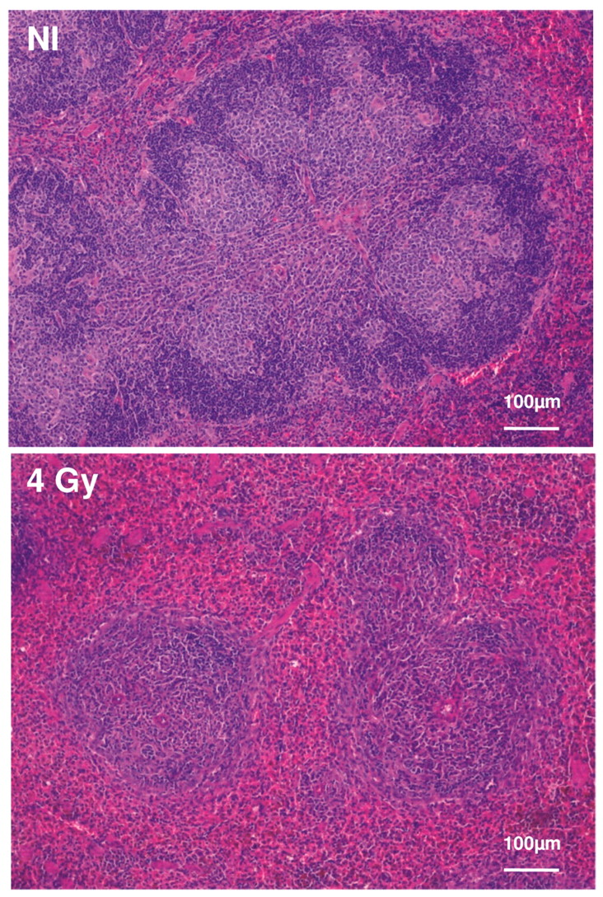

Hematoxylin-eosin staining of the spleen.
ANAÏS ALTMEYER et al. In Vivo 2011;25:1-9
Copyright © 2011 International Institute of Anticancer Research (Dr. John G. Delinassios), All rights reserved
Notes:
Hematoxylin-eosin staining of the spleen. Three days after irradiation with fast neutrons (4 Gy), the white pulp was less abundant, corresponding to radiation-induced apoptosis of spleen cells.

