Slide 1
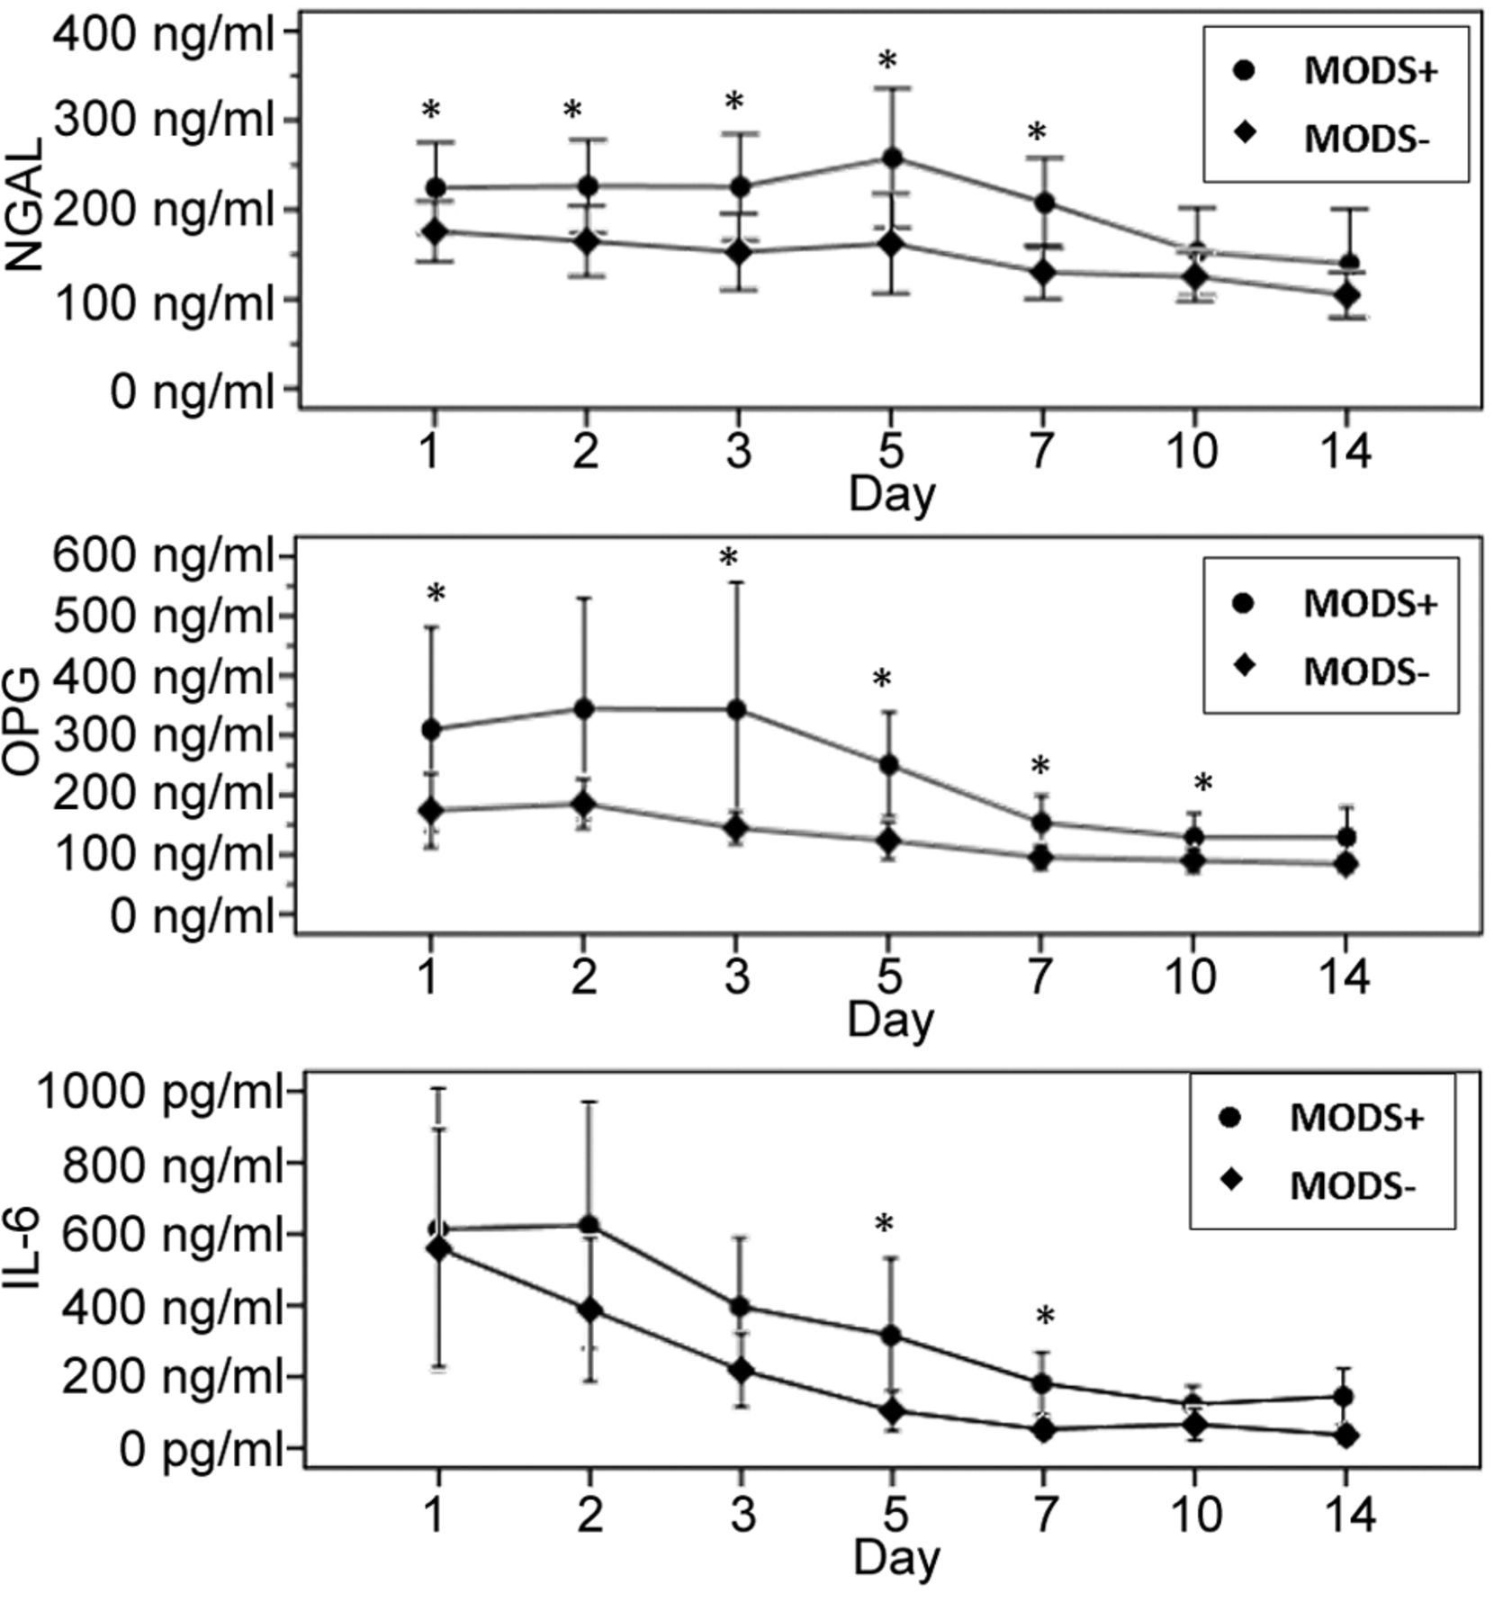

Plasma levels of NGAL, OPG and IL-6 in patients with (MODS+) and without (MODS−) multiple organ dysfunction syndrome.
HENNING PETERS et al. In Vivo 2019;33:1573-1580
Copyright© 2019, International Institute of Anticancer Research (Dr. George J. Delinasios), All rights reserved
Notes:
Plasma levels of NGAL, OPG and IL-6 in patients with (MODS+) and without (MODS−) multiple organ dysfunction syndrome. NGAL: Neutrophil gelatinase-associated lipocalin; OPG: osteoprotegerin; IL: interleukin; MODS: multiple-organ dysfunction syndrome; mean and 95 percent confidence interval; significant differences between measurements according to repeated measures ANOVA with Greenhouse-Geisser correction [NGAL F(3.45, 106.91)=3.65, p=0.01, η²=0.11, OPG F(1.80, 55.77)=11.93, p<0.001, η²=0.28 and IL-6 F(1.43, 44.44)=1.09, p=0.001, η²=0.26]; *p<0.05 at the respective time (Mann-Whitney-U-test).

